Slide 1
Beth Israel Lahey Health
System Overview & Innovation Priorities
September 30, 2026

Slide 2





Today’s Conversation
An introduction to Beth Israel Lahey Health
01
02
03
04
05
BILH at a Glance
Care Model Innovation
AI Transformation
Digital Health Launchpad
Discussion
Who we are: our scale, footprint, and strategic growth
Virtual primary care, virtual cardiac rehab, remote monitoring, and more
What we have deployed, how we choose, and where we are headed
Our new Bridge & Accelerator programs for startups and clinicians
Where UK innovators and BILH leaders can work together

Slide 3
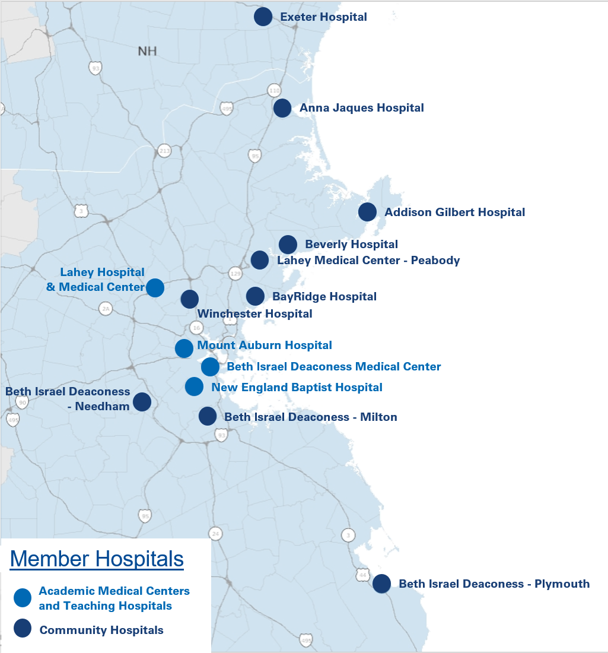
BILH System Overview
A Comprehensive System of Care
A Coordinated System of Care
Beth Israel Lahey Health is a comprehensive, high-value system of care across Eastern Massachusetts and Southern New Hampshire. BILH offers the full continuum of care, from community and ambulatory care, and post-acute services to advanced tertiary/quaternary care. Our 6,500 physicians and 39,000 employees are committed to our shared purpose to create healthier communities – one person at a time – through seamless care and ground-breaking science, driven by excellence, innovation and equity.
Together, as a coordinated system of care, we are doing more than we ever could alone. We are solving more problems. Helping more people. Making more breakthroughs. Making a difference.
3

Slide 4



System Overview
BILH by the Numbers
1.7M
39k
$8.3B
$163M
Community Benefit Investment (FY23)
Unique patients
annually
Operating Revenue
Employees
14
100+
Primary Care Locations
2,500+
Residents & Fellows
Hospitals
1,100+
2,533
4.1M
Medical Students
Inpatient Beds
Outpatient Encounters
137k
$320+
Annual
Discharges
Million in Research Funding
111k
Annual
Surgeries
111k
3,300+
Annual
Surgeries
Active Clinical Research Studies
4

Slide 5



BILH and Dana Farber
Cancer Care For the Future
Beth Israel Dana-Farber HMFP Cancer Collaboration
A new multi-decade relationship between Beth Israel Deaconess Medical Center and Dana Farber Cancer Center that will redefine cancer care in the Northeast and beyond. This will be the first free standing cancer hospital in the Northeast.

Slide 6

Innovation at BILH
Four ways we are reshaping how care is delivered
AI Transformation
Digital Health Launchpad
New Models of Care
Research & Collaboration
36 AI & automation solutions live across clinical, operational, and administrative workflows
New Bridge & Accelerator programs linking startups and clinician-innovators to our clinical infrastructure
Virtual-first primary care and employer solutions that bring care closer to the communities we serve
$320M+ in research funding, 3,300+ active clinical studies, and the Beth Israel Dana-Farber collaboration
Examples of Innovation in practice: Lahey Hospital & Medical Center’s track record of digital health innovation
External Partnerships & Collaborations
ALTA Platform: robotic patient-handling platform from Able Innovations
Zappix: AI-powered digital patient access platform
UltraSight: AI-powered cardiac ultrasound at the point of care
Internal Innovators & Engagement
Care-AI-Thon: clinician-first “hack-a-thon” for lung cancer screening
AI Healthcare Registered Apprenticeship: with Northeastern University
J&J Nurse Innovation Fellowship: Lahey nurses in this year’s cohort

Slide 7





Care Model Innovation
Rethinking where care happens and who does the work
Four forces reshaping U.S. care delivery, and they are one problem
Our response: two release valves
Margin compression
Supply & demand
Capacity inside the four walls is bounded by buildings, rooms, and licensed people. Demand is not.
2.5%
expected annual growth in payment, against labor costs rising 4.2%
10,000
new Medicare enrollees every day, meeting an aging clinical workforce
1. Decouple care from place
Virtual primary care, virtual cardiac rehab, remote monitoring, virtual behavioral health, hospital at home
Provider experience
Patient experience
2. Decouple work from people
Clinicians spend too much time on work that does not need their training
Patients want access, and a relationship that holds over time
Where it is safe: AI, automation, and smarter default workflows that free clinicians for work only they can do
Sources: CMS Office of the Actuary; Kaufman Hall National Hospital Flash Report

Slide 8
Case Study: Virtual Cardiac Rehab
One service line, rebuilt against all four problems at once
The problem
What we changed (none required new clinical capability)
1.6%
1
Default referral orders in Epic: The right referral no longer depends on someone remembering
of 87,733 eligible patients captured in FY23
2
Proactive outreach: The system reaches out to eligible patients instead of waiting to be found
Cardiac rehab can add up to five years of life and cut hospitalizations by 30%, yet 90% of U.S. patients never finish it
3
A virtual option: Delivered with digital health partners Recora and Aviary Health: same protocol, 2–3 sessions a week, at home
The results
5.2×
43%
280+
35,000+
“In-person volume held steady. This is added capacity, not shifted capacity.”
No capital spend; scarce in-person slots preserved for those who need them
growth in monthly referrals
increase in 30-day enrollment
zip codes reached in MA & NH
virtual sessions delivered
~1,000 more referrals a month
Across 10,581 referral orders
~8× footprint, no new space
Virtual census 0 → 300 by May 2026

Slide 9




The Pattern Repeats Across the Continuum
Virtual and remote care models at BILH
Virtual Primary Care
Hypertension Remote Monitoring
Virtual Behavioral Health
24/7 Virtual ED Psychiatry
Hospital at Home
Live
Live
Live
In development
Expanding
Launched 2025 with 23 clinicians
1,200+ patients in year one
<5% of visits redirected to in-person
775 patients across 34 practices
Care gaps closed at 6 of 7 targeted practices
17% dropout vs. 25–35% nationally; diabetes next
Reaching communities where BILH has no physical presence
Round-the-clock virtual psychiatry consults for emergency departments
Federal authority now extended through September 2030
Runway to build acute care capacity at home
The lesson: these models fail as device or technology programs and succeed as care models. Sustained engagement, not enrollment, is the hard part, and it is where partners who design for workflow and relationship stand out.

Slide 10
BILH AI Transformation
FY26 at a glance: from strategy to embedded, everyday use
36
7
97%
4
AI & automation solutions implemented
solutions meaningfully adopted
of AI-drafted nursing shift notes signed
value domains targeted
29 newly launched in FY26
>60% of target users weekly; 5 more strong candidates
360K drafts since April 2026 go-live
Clinical insight, workforce, patient experience, operations
How a new AI solution gets to BILH: every project routes through our AI Center of Excellence (AICE)
1
Project Initiation
2
Technical & Business Evaluation
3
Risk Assessment
4
Final Approval
Use case and/or vendor solution submitted to the AICE by a sponsor
AICE checks for existing solutions; tech team prototypes; workgroup review
Review by the Responsible Use of AI Committee and other groups
Larger or system-wide projects reviewed by the AI Executive Steering Committee

Slide 11






AI in Action
Examples of solutions now embedded in daily workflows
BILH HealthDocs AI
Heidi AI Scribe
Epic Outpatient Insights
Built in-house
Partner
Partner
Reads, identifies, and routes incoming faxes into Epic for each patient
Ambient AI that drafts clinical notes from patient conversations
Auto-generated problem-based summary for every scheduled visit
2.14M
documents processed across 115 practices
74%
less after-hours documentation; ~110K encounters, 47 specialties
371K
summaries generated in August 2026 alone
Draft End-of-Shift Notes
AI Agents for IT Service Desk
AI-Enhanced MRI
Partner
Partner (AWS)
Partner (GE, Siemens, Philips)
Generative AI drafts nursing care plan notes from the day’s events
Conversational voice agents answer incoming IT support calls
Faster, clearer scans that flag regions for radiologist review
97%
of drafts signed as care plan notes
100%
of inbound calls handled first by AI, with escalation
13
MRI scanners upgraded across 7 hospitals

Slide 12














BILH AI & Automation Roadmap
Clinician & Patient Empowerment: Our Partner Ecosystem
AI Adoption Priority | Area of Focus / Use Case | Initiatives & Status
Clinician & Patient Empowerment | Generating & Using Clinical Notes/Data
 | Remote Patient Monitoring
 | Voice Agents
 | Patient Access & Care Navigation
 | Clinical Decision Support
 | Augmenting Diagnostics/Imaging
 | Medication & Chronic Disease Mgmt
*
Stages
- Implemented/Optimize
- Development
- Under Review
*Inclusive of Chart w/ Art – an AI scribe functionality for physician and nurse documentation in Epic; capable of creating orders in Epic based on conversations with patients

Slide 13





BILH AI & Automation Roadmap
Enterprise AI & Strategic Differentiation
The rollout of enterprise-wide solutions like Claude represent shifts in how work will be performed across the system and will require intentional change management efforts to ensure effective adoption by the target audiences
AI Adoption Priority | Area of Focus / Use Case | Initiatives & Status
Strategic Workforce Enablement | Enterprise-grade AI Assistant
 | Agent Development
Research & Education | Optimize Gateway & Model Utilization
Technology Development (Strategic Differentiation) | Enterprise Partnership for LLM Development
BILH Chat Gateway
LLM Development & Pre-Training
Stages
- Implemented/Optimize
- Development
- Under Review

Slide 14



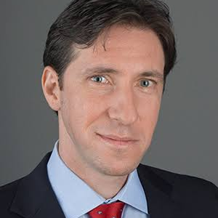


Center for Medical and Procedural Intelligence
  Organizing principles
“The reality layer for medical and surgical AI”
Bringing together medical and surgical intelligence with a focus on accessible data and industry collaboration to move the field forward.
Four pillars
Benchmarking and technical guidance for regulators
Curating high-quality
multimodal data sets
Creating interfaces for research with rich multimodal data
Collaborative development and research with industry

Slide 15
Center for Medical and Procedural Intelligence
  Our roadmap for the first year
Internal governance and compliance
Legal pipeline for de-ID datasets
Finalized stable co-development pathway for industry relationships
Unified governance of AI resources for research
Internal assets
Large de-ID datasets, ready for use with external partners
Centralized resources with an interface for querying multimodal data
Staff of analysts, ETL specialists, and software engineers
Visiting scientists from industry
Access to high-power onsite computing services
Externally-facing projects
Industry reports
Benchmark delivery to FDA/lab partners

Slide 16






Center for Medical and Procedural Intelligence
  Current and Future Projects
Google: Phase I clinical trial of patient-facing AI
Google DeepMind: Research collaboration to build AI-first clinic of the future at BIDMC
Meta: Meta egocentric human-AI collaboration
Microsoft: Research collaboration agreement for optimizing patient-facing AI care
Amazon (one medical): Benchmark metrics for patient-facing and doctor-facing AI
NVIDIA: funding to support independent benchmarking leaderboards
Also funded projects from NIH, National Academy of Medicine, ARPA-H, Moore Foundation, Macy Foundation

Slide 17





BILH Digital Health Launchpad
Our Bridge & Accelerator programs
Mission
Accelerate the development of digital health technologies that transform how care is delivered, by leveraging BILH’s diverse patient populations, real-world clinical settings, and integrated care infrastructure to deploy solutions that improve outcomes, expand access, and bring care closer to the communities we serve.
The programs aim to:
Enhance Operations
Enhance Clinical Insights
Empower Teams
Reduce clinical and administrative burden through AI-assisted workflows, smart supply chain, and predictive staffing
AI-powered diagnostics, personalized care, and predictive models for early intervention
Reduce burnout and improve satisfaction by automating documentation and routine tasks
Promote Financial Sustainability
Improve Patient Experience
Competitive Positioning
Improve margins through billing automation, operational AI, and revenue diversification
Expand reach through virtual care, remote monitoring, and personalized care pathways
Make BILH a preferred academic validation partner and a hub that attracts talent

Slide 18




Two Paths into BILH
The Bridge & Accelerator programs
The Bridge Program For external health tech startups
The Accelerator Program For BILH clinician-innovators
Connects early-stage startups with BILH’s clinical infrastructure and data for clinical validation and co-development
Eligibility: Working prototype (not just a concept) and a serious commercial effort
Supports the commercialization, validation, and deployment of solutions created by BILH clinicians
Eligibility: Past the idea stage: something built, even if early, ready for business-model testing
Most relevant today
What participants receive
Business & Financial
Technical Infrastructure
Clinical Expertise
Mentorship & Training
Legal & IP Support
Economic validation & ROI modeling
Fundraising & investor preparation
Success metrics & milestones
HIPAA-compliant cloud sandbox (AWS)
Epic & HL7/FHIR integration support
AI lifecycle mgmt, architecture & cyber review
Medical director oversight
Domain subject matter experts
Rigorous clinical validation & de-identified data
Entrepreneurs-in-residence
External VC & industry network
Pitch, business model & go-to-market coaching
Template agreements & contracting
IP management & counsel
Data governance, compliance & regulatory

Slide 19
We Already Partner with Startups
Recent equity-based digital health partnerships at BILH
AlnuHealth
ecton
smartSTAT
Medinsight.ai
LOI signed
Signed agreement
Contract in review
Signed agreement
Digital health & coaching platform for patients on GLP-1s, with an AI-powered personal coach
AI-powered fintech providing a patient-provider healthcare payments platform
The first smart code cart with real-time inventory tracking and automated recall tracking
AI-powered, EMR-integrated patient safety platform that automates medical incident reporting
Partnership: Pilot to design, validate, and implement a GLP-1 companion platform for BILH employees, employer partners, and Lifestyle Medicine patients
Partnership: Pilot launch of ecton’s digital wallet and AI-based financial counseling platform
Partnership: Multi-site 2–6 month pilot starting in a BIDMC medical ICU, with potential expansion to three ICUs
Partnership: Design partnership supporting U.S.-market adaptation, validation, and piloting of the platform
Additional partnership with Aidoc (radiology AI) in process
What startups gain
Real-world validation across diverse populations and care settings, clinical champions, Epic integration support, and the credibility of an academic health system partner
What BILH gains
Solutions to our real operational and clinical problems, preferred pricing on adoption, and a modest equity stake negotiated case by case

Slide 20
What We Look For
Application scoring framework and launch timeline
Value to BILH & Affiliates
Alignment with mission: Strengthens care for our patients & communities; fits system goals (community care, workforce, equity, virtual care)
Launch timeline
May–Aug 2026
Operational value: Solves a key BILH problem across a full care pathway without new bottlenecks
Program design
Scope, requirements, IP policy, funds flow, scoring framework, infrastructure
Company Potential
Team: Domain expertise, track record, and full-time capacity to execute
September 2026
Stakeholder input
Brief chairs and steering committee; finalize soft-launch plan
Unique value proposition: Differentiated, high-quality offering with defined barriers to entry
October 2026
Soft launch: Bridge Program
Product Readiness
Development roadmap: Realistic time & cost estimates and a clear path to MVP or market-ready product
Transparent selection criteria and a scoring-based selection panel
Technical readiness: Pilot-level readiness or proof-of-concept; regulatory & integration needs identified
November 2026
Refine & monitor
Track early milestones; engage external partners ahead of an Innovation Summit
Each criterion scored 1 (weak) to 3 (strong); 18 points maximum

Slide 21

Let’s Build Together
Where UK innovators can plug in
Apply to the Bridge Program
Align to Our AI Priorities
Connect with BILH Leaders
Soft launch in October 2026
Working prototype and a serious commercial effort
Clinical validation, data access, and integration support
Patient access, care navigation & voice agents
Remote monitoring & clinical decision support
Revenue cycle, supply chain & workforce tools
Clinical, operational, IT, and innovation leaders are in the room today
Share the problem you solve and the evidence you have
Identify a sponsor to bring your idea forward
For discussion
Which BILH challenges map most closely to what your company solves?
What does a successful U.S. validation partnership look like for you?
What would help your team move from pilot to scaled adoption with a U.S. health system?

